Slide 1
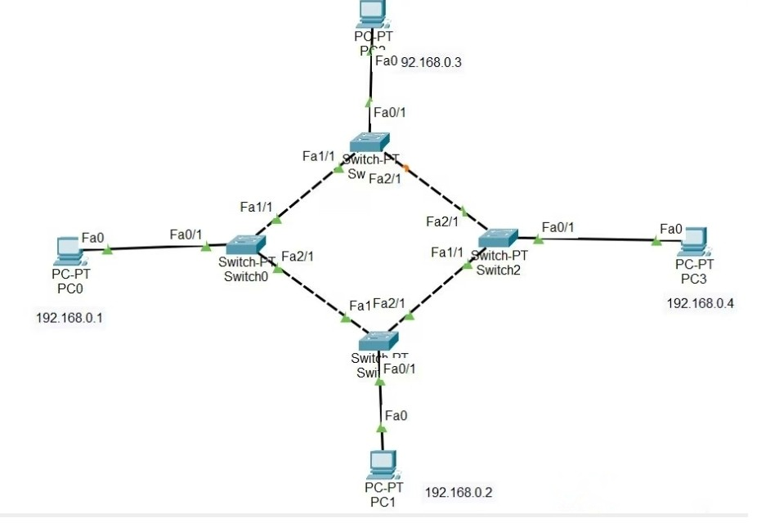
RING TOPOLOGY
Steps to Configure and Setup Ring Topology in Cisco Packet Tracer : Step 1: First, open the cisco packet tracer desktop and select the devices given below: S.NO Device Model Name 1. PC PC 2. Switch PT-Switch IP Addressing Table S.NO Device IPv4 Address Subnet Mask 1. pc0 192.168.0.1 255.255.255.0 2. pc1 192.168.0.2 255.255.255.0 3. pc2 192.168.0.3 255.255.255.0 4. pc3 192.168.0.4 255.255.255.0 Then, create a network topology as shown below the image. Use an Automatic connecting cable to connect the devices with others.

Slide 2
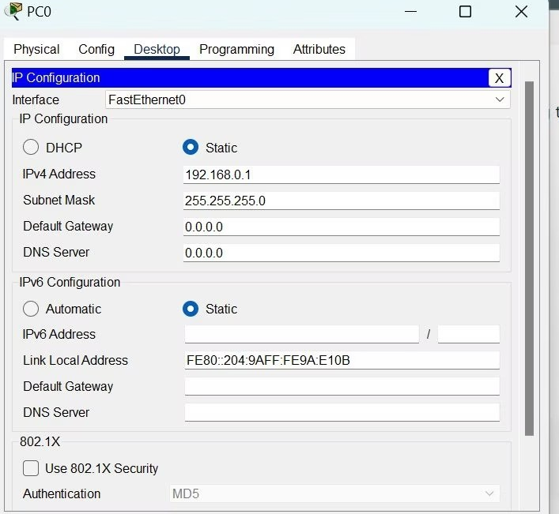
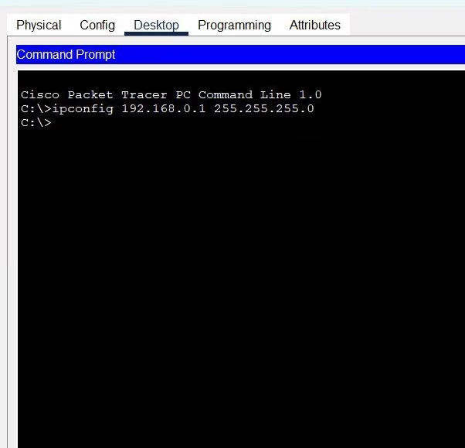
Step 2: Configure the PCs (hosts) with IPv4 address and Subnet Mask according to the IP addressing table given above. To assign an IP address in PC0, click on PC0. Then, go to desktop and then IP configuration and there you will IPv4 configuration. Fill IPv4 address and subnet mask.
Go to the command terminal of the PC. Then, type ipconfig

Slide 3
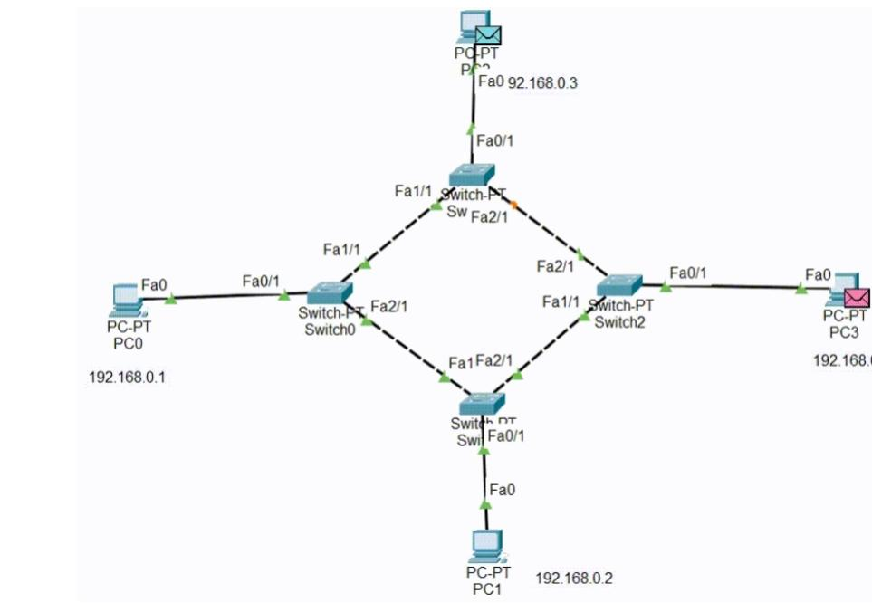
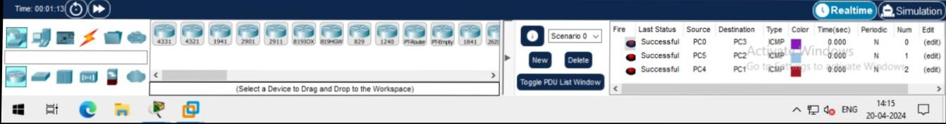
Verify the connection by pinging the IP address of any host in PC0. Use the ping command to verify the connection. As we can see we are getting replies from a targeted node on both PCs. Hence the connection is verified.
Stimulate pc0 to P To pc

